Slide 2
Portfolio Assignment

Slide 3

Den gode opgave

Slide 4
1: Structure
Keep a stucture similar to this:
Introduction (Main topic, why is this interesting?)
Main question/goals (What are you trying to do?)
Methodology (How are you going to do it?)
Analysis (Putting it all together)
Conclusion (What does it all mean?)

Slide 5
2: Form
Proper referencing is SUPER important!
My recommendation – Do it Harvard Style! http://www.library.auckland.ac.nz/instruct/ref/harvard.html
But above all – be consistent!

Slide 6
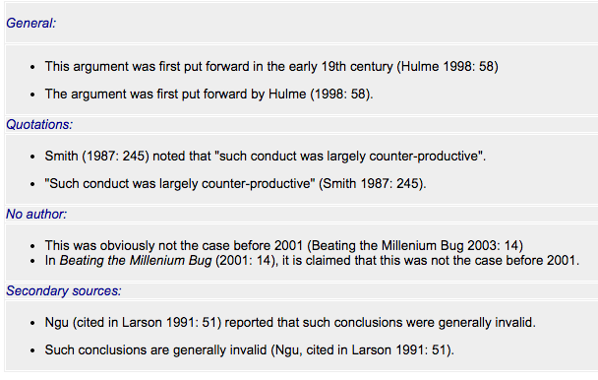

Slide 7
3: Think of tHE reader
The first time you introduce a new person or term, it might be a good idea to include a very brief explanation (if it’s not already included in the methodology part)
But keep it short! It’s to increase readability – not to show your ability to copy from Wikipedia!
If more space is required – consider using a footnote.
New terms must be in italic the first time!

Slide 8
4: Keeping an academic tone
Minimize the useage of ”I”, ”me”, ”us” etc.
”Write yourself out of the paper”
You are not ”allowed to have an oppinion”
Construct your arguments through the texts, citations and references
A citation/quote no longer than 1-2 lines can be used directly in the text, remember citation marks and source!
As a rule of thumb: Citations larger than 2 lines should be clearly distinguishable from the rest of the text

Slide 9
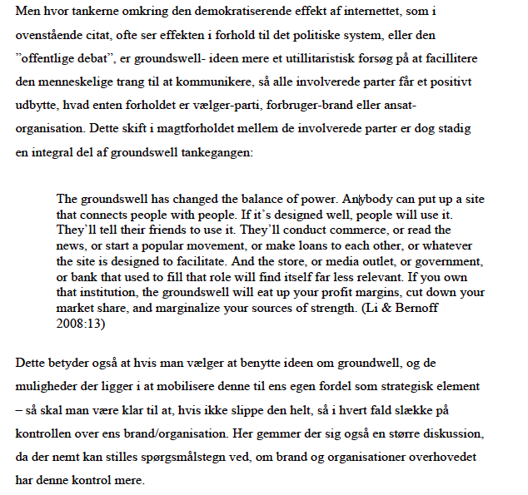

Slide 10
The Assignment
Goal:
To show an understanding of what has been presented so far
Form: 3-4 pages (between 6300-8400 characters, including spaces)
When:
Onsdag the 22th of march at 12:00 – Gives me a chance to get them back to you on the 28th
Grading:
Pass/fail – if you fail, you have to rework it, and turn it in again.

Slide 11
But remember
3-4 pages is not a lot – don’t try to cover everything!
It’s up to you guys to pick a case, and apply some of what’s been presented so far to it in a meaningful manner. That is PART of the assignment. If in doubt ask! I’m more than happy to help – but I won’t spoon-feed it to you.
It could be something in the vein of: ”How does the Wii utilize our familiarity with the everyday world, and how does it differ from a more traditional approach to gaming, as exemplified by the games WiiSports and Virtua Tennis”

Slide 12
Opgaven
Redegør for Verplanks Do-Feel-Know Analyser en app/internet service som I benytter jer af, og prøv at benyt begreberne præsenteret af Verplank, i forbindelse med Kolko og/eller kap 1 i ID

Slide 13
But REMEMBER pt 2
Look at the list of different cases and technologies we made the first lecture for inspiration! (I would rather not have to read 25 assignments about the Wii)
You don’t have to reinvent the wheel – it’s an exercise in showing understanding for the subject matter, and the from in which it is presented! Not conducting new and ground-breaking research.

